Slide 1
DIGGING EXPERT DIRT
Johnny M. Simon, The Simon Law Firm, P.C.

Slide 2
EXPERT DIRT – THE WHY
Bane of modern day litigation
Juke Box Expert
Cigarettes are not addictive
Opioids are not addictive
OBGYN cannot breach the standard of care
Flashy, shiny, & persuasive

Slide 3
You make your case with your experts…
You win your case with theirs.

Slide 4
Impeach & Destroy
Admissions – Build Your Case
Show How Unreasonable Position

Slide 5
When should you start?
Yesterday…
As soon as experts are disclosed.

Slide 6
How to do it?
No limit but determination and creativity.
The Internet Has Changed The Game.
Systematically.

Slide 7
Systematically
Google
The CV or Resume
Prior Depositions & Testimony
Social Media
West Law People map
Publications

Slide 8
Step 1: Google Your Expert
Get a feel for their online presence.
Do they have their own website?
Are they advertise?
Online content: Interviews? Blogs? Podcasts?
Get an idea of expert witness experience
https://painstrategy.com/
https://www.oralsurgeryexpertwitness.com/

Slide 9
Step 2 - The Curriculum Vitae
The 100 Page CV - Treasure Trove of Information
Springboard for Ideas
Has the Expert said or written anything (whether in or outside the litigation context) about the issues in your case?

Slide 10
CV – Present & Past Employers
Who is his employer?
Expert Witness Guidelines
Expert Witness Disclosure Rules
Substantive Information Published by Employer that Contradict Opinion in your case
Jumped Around Employers

Slide 11
The CV – Memberships & Societies
Experts Love to Join Seemingly Prestigious Organizations
Don’t Know a Thing About Them
Material Published by Organizations
Rules Promulgated by Organizations
Organizations That Are Embroiled in Controversy

Slide 12
Rules & Ethics
https://www.aao.org/ethics-detail/code-of-ethics--expert-witness-testimony
https://painmed.org/about/position-statements/guidelines-for-expert-witness-qualifications-and-testimony
Position Statements
https://www.psychiatry.org/home/policy-finder
Controversy
https://static1.squarespace.com/static/54d50ceee4b05797b34869cf/t/5a8359d2c8302530cd0d1e06/1518557657857/REPORT-Fueling+an+Epidemic-Exposing+the+Financial+Ties+Between+Opioid+Manufacturers+and+Third+Party+Advocacy+Groups.pdf

Slide 13
CV - Journals & Publications
Two Types
Anything Your Expert Has Written About Issues In Your Case
Overarching Philosophical – (Less Academically Rigorous, but Looks Good on CV). These past statements can be invaluable.
Journals of Which Your Expert Is an Editor About Issues in Your Case
***Publications Written By Expert May Not Be On CV
Sources
Google Scholar
Pub Med
Westlaw Medical Navigator
How does they write about these issues versus how they testify? Balanced approach.

Slide 14
CV – Books & Book Chapters
How textbook publishing works.
Why that can be to your advantage?
Chapter they wrote.
Chapter others wrote in the same book.

Slide 15
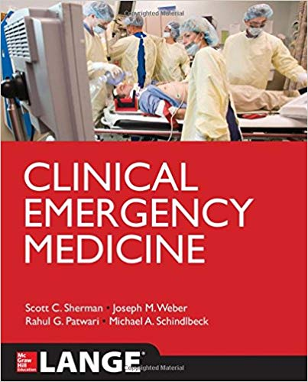
Ex.55-5

Slide 16
Research Grants, Contracts, Awards
Pharma’s Influence on Medicine
Who is paying them is a potential bias
Obscene Amounts of Money
Dollars For Docs – Data Aggregated by Federal Government
https://projects.propublica.org/docdollars/

Slide 17
The CV – Teaching Activities
Does he or she teach/ if so, with what materials.?
Lectures – with what materials.
What he or she is saying inside the courtroom same as outside?

Slide 18
Step 3 - PRIOR DEPOSITIONS & EXPERT REPORTS
How to Structure: BQMLL
Admissions Re: Background & Qualifications
Admissions Re: Money
Admissions Re: Liability (What Standard of Care Requires, Or May Constitute Danger/Defect)
LIES
GOAL: Have everything expert has said under oath prior to deposition.

Slide 19
Where to look?
Westlaw Experts
Trial Smith
Attorney Information Exchange Group
American Association for Justice
Google
Listserve (local and in expert’s home state)
Calling prior attorneys.

Slide 20
STEP 4 – SOCIAL MEDIA
Public Figures
Facebook, Twitter, Linkedin, Instagram.
Professional? Or Personal?
Articles, studies, or news shared – endorsement?
Assess their connections? Defense attorneys?
Assess their “Interests”
$$$$$$$$ - Jim Gilbert Story

Slide 21
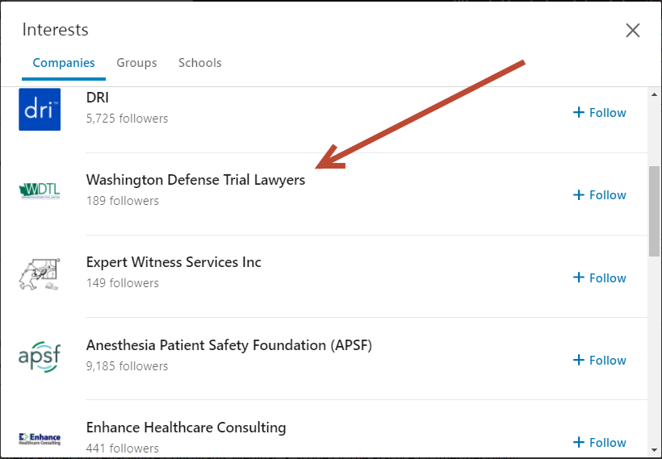

Slide 22
Step 5 – Westlaw People Map
Tool for Collecting Background Information
Professional Licenses
Past Civil Judgments
Corporations Owned
Properties Owned

Slide 23
Step 6 – Publications, Articles, Books
Publications that are generally authoritative or reliable in field that contradict what expert is saying. These articles/texts are often called the “Bible” or “Gold Standard”
Expert may have admitted to consulting these publications
Uptodate***

Slide 25
No limit
Art & Science
Determination & Creativity
Cross Examination Excitement
Case Ending

Slide 26
THE END

