Slide 1

Arguing Damages
LSEM
June 22, 2021

Slide 2
Fundamental Truths
Jurors don’t care about your client.
Logic and reason don’t matter.
Jurors decide cases on emotion.

Slide 3

PERSUASION
LOGIC
TRUST
EMOTION

Slide 4


Slide 5


Slide 6
MAI 3.01
In this instruction, you are told that your verdict depends on whether or not you believe certain propositions of fact submitted to you. The burden is upon the party who relies upon any such proposition to cause you to believe that such proposition is more likely to be true than not true.

Slide 7
MAI 2.04
The verdict form included in these instructions contains directions for completion and will allow you to return the permissible verdict in this case. Nine or more of you must agree in order to return any verdict. A verdict must be signed by each juror who agrees to it.

Slide 8
MAI 17.01
  …such negligence directly caused or directly contributed to cause damage to plaintiff.

Slide 9
MAI 4.01
If you find in favor of the plaintiff, then you must award plaintiff such sum as you believe will fairly and justly compensate plaintiff for any damages you believe plaintiff sustained and is reasonably certain to sustain in the future as a direct result of the occurrence mentioned in the evidence.

Slide 10
MAI 5.01
If you find in favor of the plaintiff, then you must award plaintiff such sum as you believe will fairly and justly compensate plaintiff for any damages you believe plaintiff and decedent sustained and plaintiff is reasonably certain to sustain in the future as a direct result of the fatal injury to decedent.
You must not consider grief or bereavement suffered by reason of the death.

Slide 11
RSMO 537.090
…and the reasonable value of the services, consortium, companionship, comfort, instruction, guidance, counsel, training, and support of which those on whose behalf suit may be brought have been deprived by reason of such death…

Slide 12


Slide 13
He is doing okay now!
Stuff happens, just deal with it!
He doesn’t need all that money!
Lawyers will get most of it!
Insurance rates will go up!
Government programs are available!
Money won’t fix his problems!
His family can take care of him!
Injuries &
Damages
Sustained
Cousin Bobby got hurt, he didn’t get any money!

Slide 14
SARAH

Slide 15
Instruction No. 9
If you find in favor of Plaintiff, then you must award Plaintiff such sum as you believe will fairly and justly compensate Plaintiff for any damages you believe Plaintiff sustained and is reasonably certain to sustain in the future that the occurrence mentioned in the evidence directly caused or directly contributed to cause. Any damages you award must be itemized by the categories set forth in the verdict form.

Slide 16
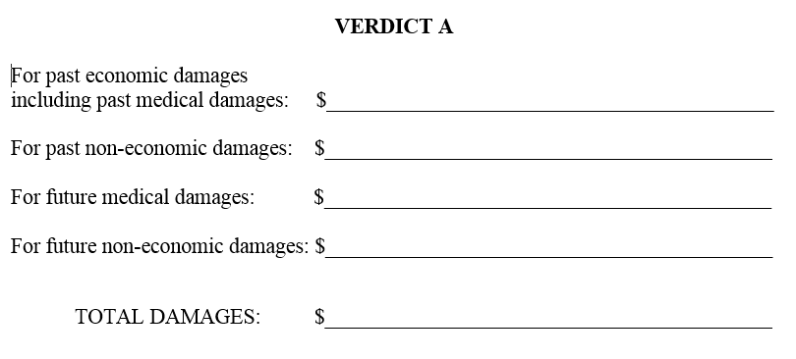

Slide 17
Instruction No. 10
In these instructions, you are told to itemize any damages you award by the categories set forth in the verdict form.
The phrase “past economic damages” means those damages incurred in the past for pecuniary harm such as medical expenses for necessary drugs, therapy, and for medical, surgical, nursing, X-ray, dental, custodial, and other health and rehabilitative services and for past lost earnings and for past lost earning capacity.
The phrase “past non-economic damages” means those damages arising in the past from non-pecuniary harm such as pain, suffering, mental anguish, inconvenience, physical impairment, disfigurement, and loss of capacity to enjoy life.
The phrase “future medical damages” means those damages arising in the future for medical expenses such as necessary drugs, therapy, and medical, surgical, nursing, X-ray, dental, custodial, and other health and rehabilitative services.
The phrase “future non-economic damages” means those damages arising in the future from non-pecuniary harm such as pain, suffering, mental anguish, inconvenience, physical impairment, disfigurement, and loss of capacity to enjoy life.

Slide 18
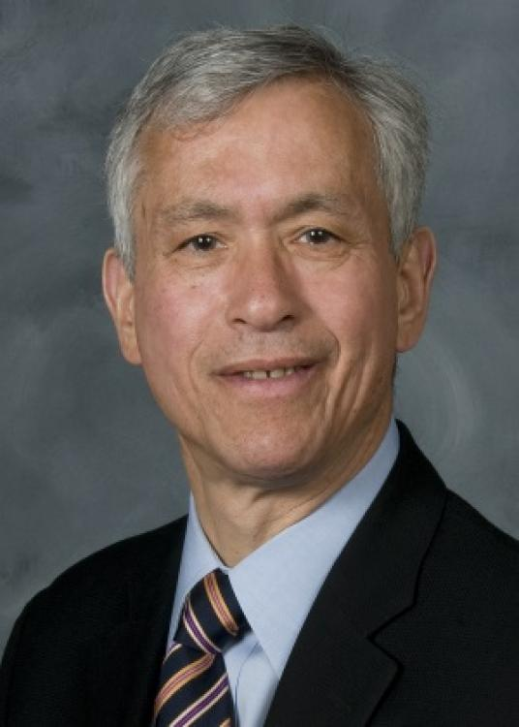
Board certified pediatrician for 40 years
Certified Life Care Planner
Treated thousands of sick children
Subspecialty in Pediatric Infectious Disease
Chief of Pediatrics at Shiner’s Hospital for Children for 36 years
Internship and residency in Pediatrics at Yale
Fellowship in Pediatric Infectious Disease at University of Chicago
Dr. Lawrence Vogel

Slide 19
Reviewed 10K+ pages of medical records
Conducted research into specific diseases
Met and evaluated Sarah and family
Visited Sarah’s school
Drafted 18-page life care plan listing every line item of care Sarah will need and rationale for each
Reasonable degree of medical certainty
Dr. Lawrence Vogel

Slide 20
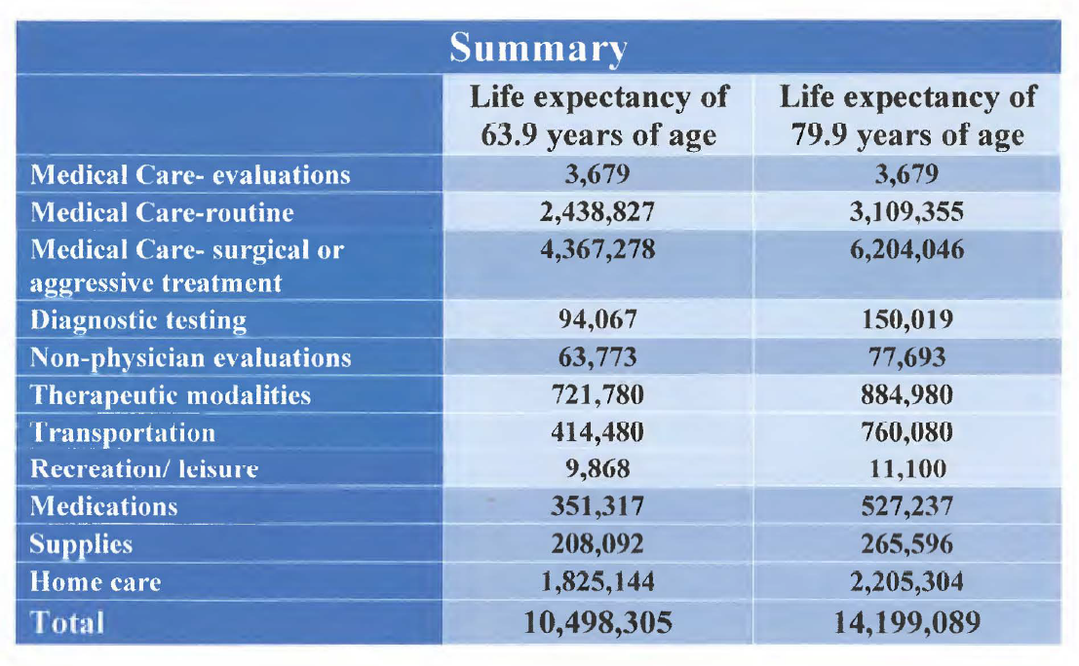

Slide 21
1,200,000
10,498,305 - 14,199,089

Slide 22
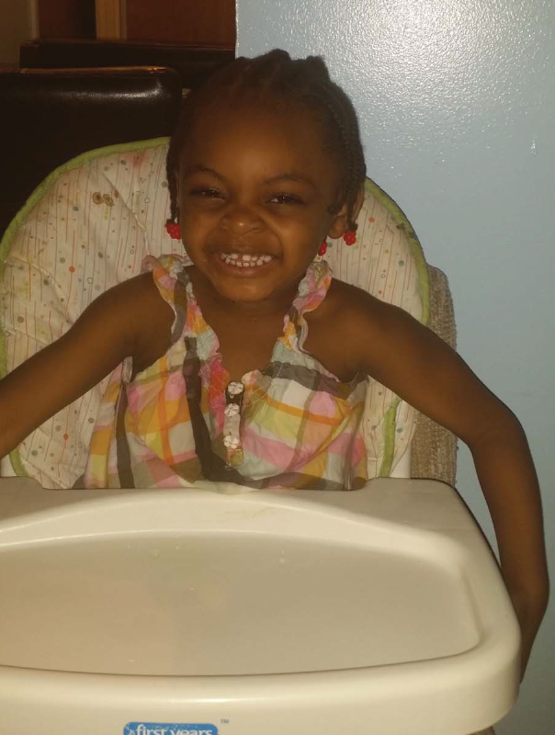
Harms and Losses

Slide 23
Past Harms and Losses
Admitted to Hospital on Verge of Death
Dehydration Leading to Kidney Injury
Emergent Dialysis – Eventual Catheter Surgically Placed into Jugular Vein
Neurological Failure, Stroke & Seizures
Unresponsive
Paralyzed
Colonic Stricture + Colostomy Bag
Drooling
Feeding Tube
Brain Damage
Lung Collapse + Endotracheal Intubated
Hand Wound + Plastic Surgery
Insulin Dependent Diabetes
Restricted Diet
Inability to Speak, Cry or Smile
Extreme Weight Loss & Weakness
Intensive Rehabilitation: Speech, Occupational, Physical Therapy
End Stage Renal Disease
Dialysis 3-4 x Weekly
Missed School
Neurocognitive Injury
Around the Clock Care
Kidney Transplant
Complications
Hospitalizations
Fear & Anxiety
Loss of Childhood
Needle Punctures 4xDay

Slide 24
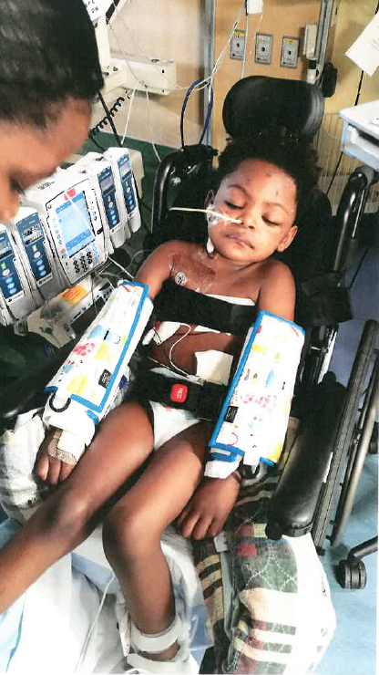
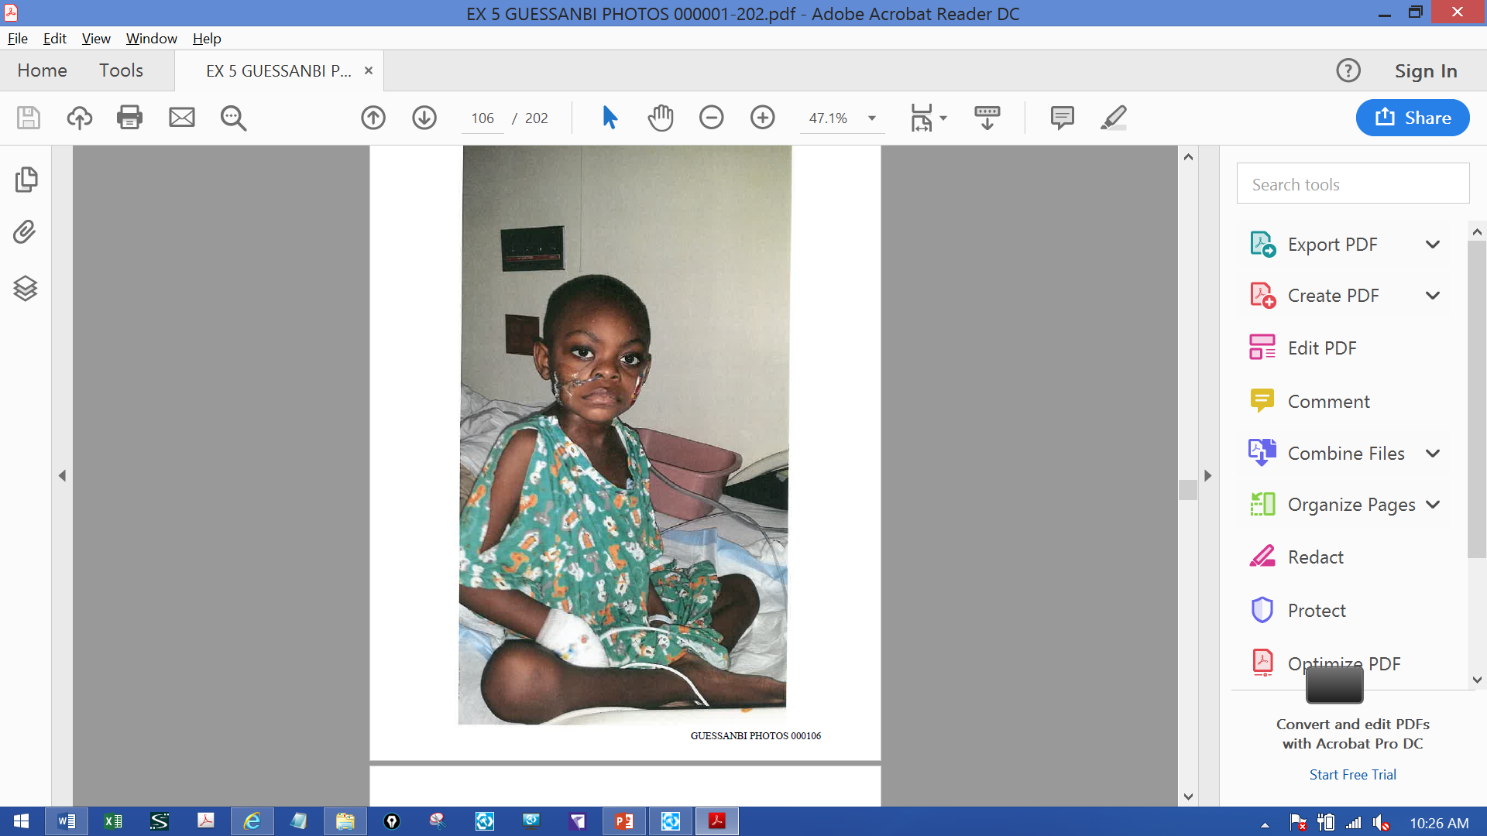

Slide 25
What Kind of Life Has Sarah Been Left With?
Hospitalizations
Future Transplants
Anguish of Waiting for a Donor
Right to Live Life Free from Handicap
Right to be a Child
Right to Live Free of Pre-mature Death
Right to Navigate into Womanhood without Burden of Disease
Fear of Not Being Wanted
Discerning Vocation
Life as a Burden on Others
Emotional Scars
Can’t Grasp Quite as Quickly – Effect on Community (Difference Between Greatness and Mediocrity)
Loss of Enjoyment of Life
Physical Impairment
Disfigurement
Loss of Capacity to Enjoy Life

Slide 26
1,200,000
1,200,000
5 Million
10,498,305 - 14,199,089
10,498,305 - 14,199,089
15-25 Million

